Slide 1
Refactoring-II

Slide 2
Definition
Refactoring is changing a software system by improving its internal structure without changing its external behavior, i.e. it is a technique to restructure the code in a disciplined way.
It makes the software easier to understand and cheaper to modify.
Refactoring is an overhead activity.

Slide 3
History of Refactoring
Two of the first people to recognize the importance of refactoring were Kent Beck and Ward Cunningham
They worked with Smalltalk from the 80's onward.
Refactoring has always been an important element in the Smalltalk community.
Ralph Johnson's work with refactoring and frameworks has also been an important contribution.

Slide 4
Why Refactor ?
Improves the design of software
Without refactoring the design of the program will decay.
Poorly designed code usually takes more to do the same things, often because they does the same thing in different places
Easier to understand
In most software development environments, somebody else will eventually have to read your code so it becomes easy for others to comprehend.
To find the bugs
It helps in finding the Bugs present in the program.
To program faster
It helps us to do the coding/programming faster as we have better understanding of the situation.

Slide 5
When to Refractor ?
When you add a function
Helps you to understand the code you are modifying.
Sometimes the existing design does not allow you to easily add the feature.
When you need to fix a bug
If you get a bug report its a sign the code needs refactoring because the code was not clear enough for you to see the bug in the first place.
When you do a Code Review
- Code reviews help spread knowledge through the development team.
- Works best with small review groups

Slide 6
Properties of Refactoring
Preserve Correctness
One step at a time
Frequent Testing

Slide 7
Design Attributes
Abstraction (information hiding)
Flexibility
Clarity
Irredundancy

Slide 8
Steps to Refactoring
Pareto analysis helps to identify heavily used or time consuming code.
Refactoring begins by designing a solid set of tests for the section of code under analysis.
Identify problems in code by review using bad smells of code.
Perform a refactoring and test.
Pareto Analysis is a simple technique for prioritizing problem-solving work so that the first piece of work you do resolves the greatest number of problems. It's based on the Pareto Principle (also known as the 80/20 Rule) – the idea that 80 percent of problems may be caused by as few as 20 percent of causes.
Notes:
Pareto Analysis is a simple technique for prioritizing problem-solving work so that the first piece of work you do resolves the greatest number of problems. It's based on the Pareto Principle (also known as the 80/20 Rule) – the idea that 80 percent of problems may be caused by as few as 20 percent of causes.
solid set of tests : write multiple test cases for the section of the code that needs refactoring to make sure that results will not change after refactoring.

Slide 9
Continued…
The steps taken when applying the refactoring should be:
- Small enough - to oversee the consequences they have.
- Reproduce-able - to allow others to understand them.
- Generalized : they are more a rule that can be applied to any structure.
- Written down to allow sharing these steps and to keep a reference, with step by step instructions how to apply them.

Slide 10
A few Refactorings
Add Parameter
Change Association
Reference to value
Value to reference
Collapse hierarchy
Consolidate conditionals
Procedures to objects
Decompose conditional
Encapsulate collection
Encapsulate downcast
Encapsulate field
Extract class
Extract Interface
Extract method
Extract subclass
Extract superclass
Form template method
Hide delegate
Hide method
Inline class
Inline temp
Introduce assertion
Introduce explain variable
Introduce foreign method
Notes:
Consolidate the conditionals in a single expression by using and and or . As a general rule when consolidating: Nested conditionals are joined using and . Consecutive conditionals are joined with or .
Decompose conditional = inverse of Consolidate the conditionals

Slide 11

Refactoring examples
Add a Parameter :
When a method needs more information from its caller.

Slide 12
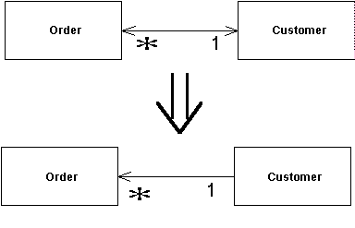
Continued..
Bi-directional Association to Unidirectional :
We have a two-way association but one class
no longer needs features from the other.
Notes:
You have a bidirectional association between classes, but one of the classes doesn’t use the other’s features.

Slide 13
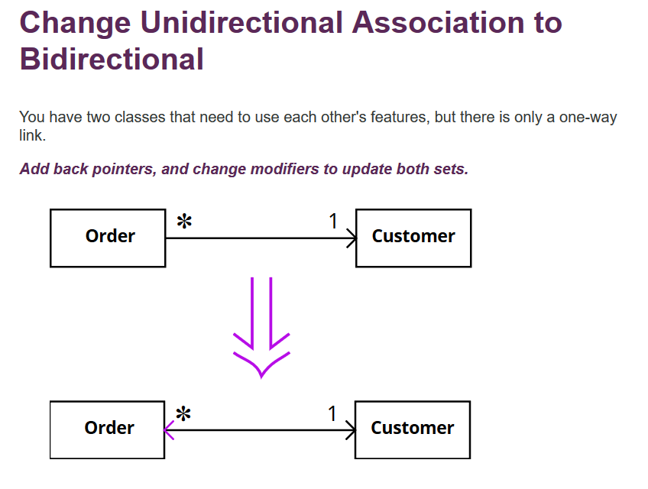

Slide 14
Bi-directional Association - Java
public class Person {
private String name;
private int age;
private String address;
public Person() {
this.name = name;
this.age = age;
this.address = address;
}
public void setName () { this.name = name;}
public void setAge () { this.age = age; }
public void setAddress () { this.address = address;}
public String getName () { return name; }
public int getAge () { return age;}
public String getAddress () { return address; }
}
public class Dog {
private String name;
private int age;
public Dog(){
this.name = name;
this.age = age;
}
public void setName () {
this.name = name;
}
public void setAge () {
this.age = age;
}
public String getName () {
return name;
}
public int getAge () {
return age;
}
}
For Bidirectional Association:
Add : Person.setDog() and Dog.setOwner()
Notes:
The main problem here is consistency: if a Dog d1 is a pet for a Person p1, then p1 must be owner of d1, and vice versa. If, as many suggested, we have 2 methods (Person.addDog() and Dog.setOwner()), then a user can easily make a mistake and fail to call both methods (or call with wrong arguments). Since a Dog can have only one owner, a simple and safe interface would be using single method Dog.setOwner(Person p), where p may be null if we want the dog to have no owner. This method, besides setting the field Dog.owner, must remove this dog from the pet list of previous owner and (if p != null) add itself to the pet list of the new owner. The methods of class Person to add and remove pets should be visible for the class Dog but not visible to the user (they should be package private), while the method Dog.setOwner should be public.

Slide 15
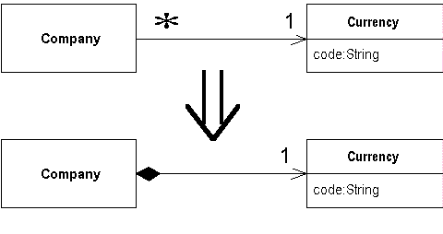
Continued…
Change Reference to Value :
Problem: You have a reference object that’s too small and infrequently changed to justify managing its life cycle.
Solution: Turn it into a value object.
Make the object unchangeable. The object shouldn’t have any setters or other methods that change its state and data (Remove Setting Method may help here). The only place where data should be assigned to the fields of a value object is a constructor.
Notes:
s

Slide 16
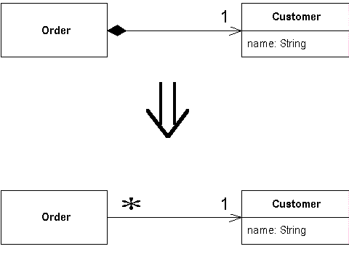
Continued…
Change Value to Reference :
When we have a class with many equal instances that we want to replace with a single object.

Slide 17
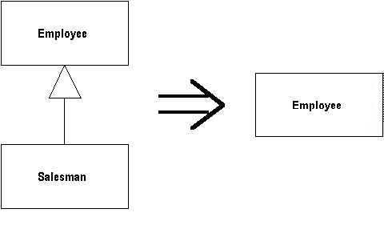
Continued..
Collapse Hierarchy :
As superclass and subclass are not very different.

Slide 18
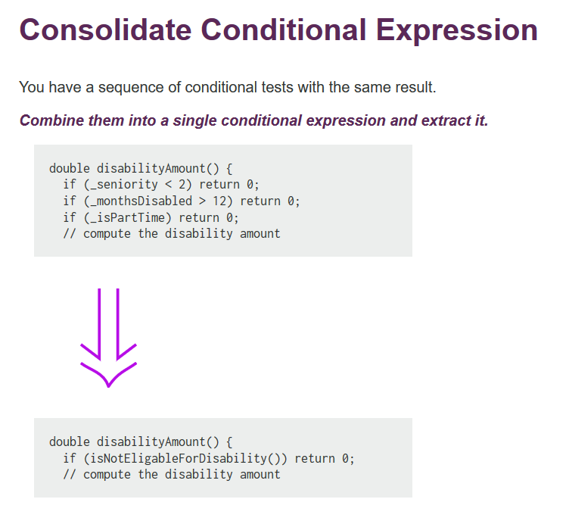
Continued…

Slide 19
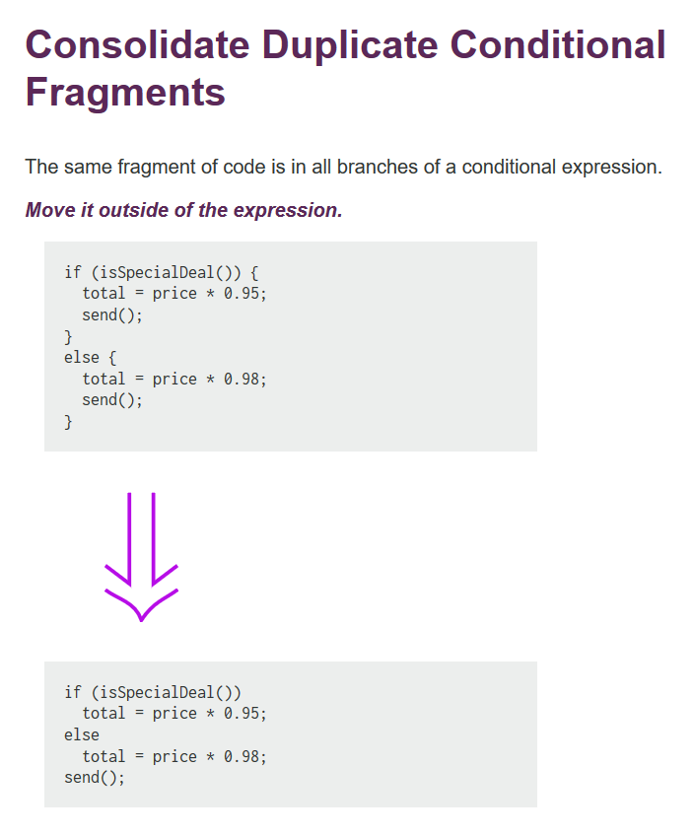

Slide 20
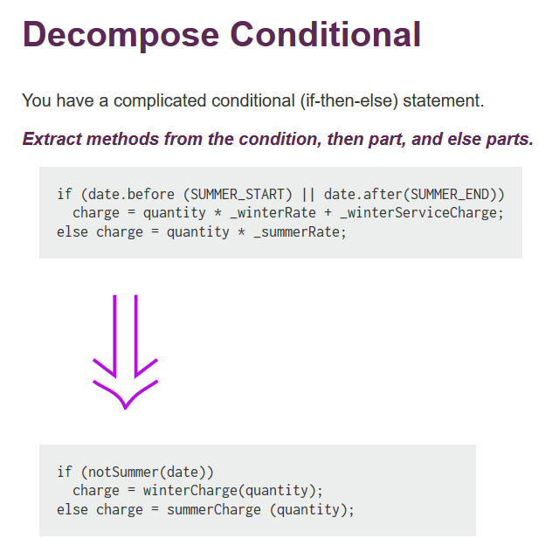
Continued…

Slide 21
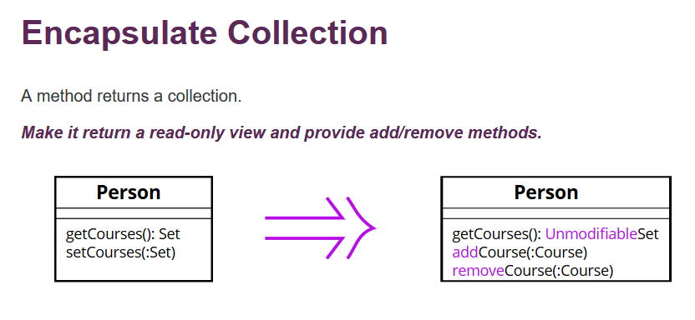
Continued..
Benefits
The collection field is encapsulated inside a class. When the getter is called, it returns a copy of the collection, which prevents accidental changing or overwriting of the collection elements without the knowledge of the class that contains the collection.
Notes:
Problem
A class contains a collection field and a simple getter and setter for working with the collection.
Solution
Make the getter-returned value read-only and create methods for adding/deleting elements of the collection.
Such a protocol properly encapsulates a collection, which ultimately reduces the degree of association between the owner class and the client code.
Benefits
The collection field is encapsulated inside a class. When the getter is called, it returns a copy of the collection, which prevents accidental changing or overwriting of the collection elements without the knowledge of the class that contains the collection.

Slide 22
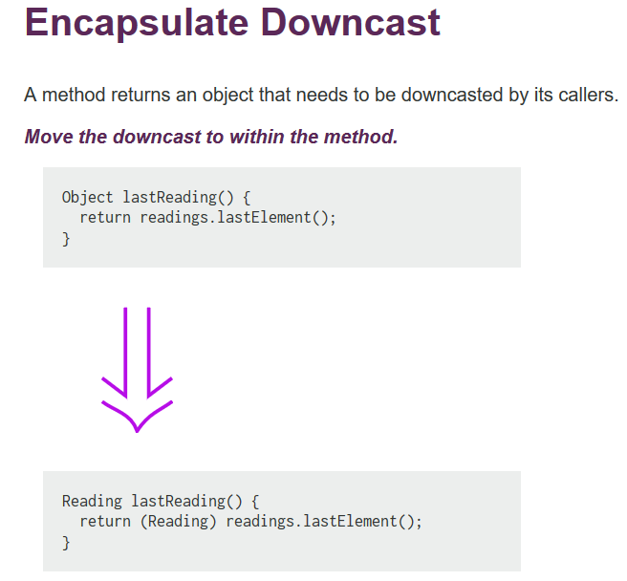
Continued..

Slide 23
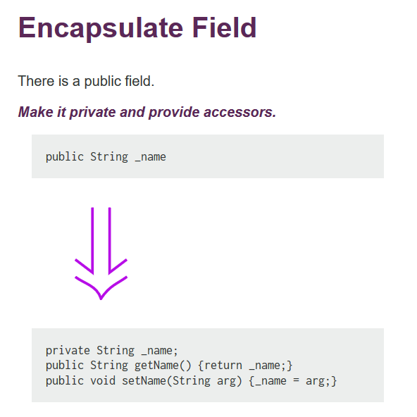

Slide 24
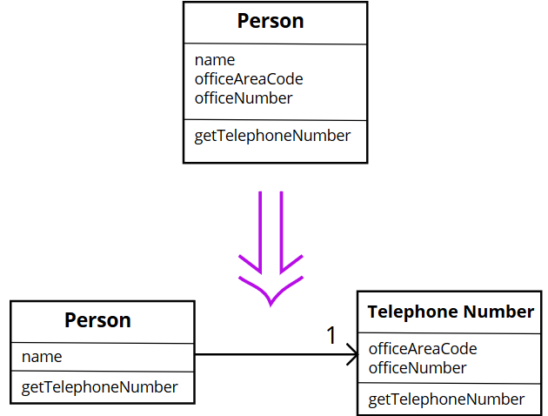
Extract class
Problem : one class doing work of two classes.
Solution: Instead, create a new class and place the fields and methods responsible for the relevant functionality in it.
Single-responsibility classes are more reliable and tolerant of changes. For example, say that you have a class responsible for ten different things. When you change this class to make it better for one thing, you risk breaking it for the nine others.
Inverse of inline class

Slide 25
Extract class example
abstract class Shape
{
public void Draw()
{
try
{
// draw
}
catch (Exception e)
{
LogError(e);
}
}
public static void LogError(Exception e)
{
File.WriteAllText(@"c:\Errors\Exception.txt", e.ToString());
}
}
class Logger
{
public static void LogError(Exception e)
{
File.WriteAllText(@"c:\Errors\Exception.txt", e.ToString());
}
}
abstract class Shape
{
public void Draw()
{
try
{
// draw
}
catch (Exception e)
{
Logger.LogError(e);
}
}
}
Before Refactoring
After Refactoring

Slide 26
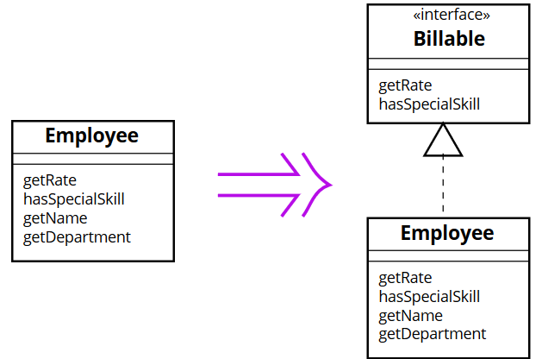
Extract interface
Problem: Multiple clients are using the same part of a class interface. Another case: part of the interface in two classes is the same.
Solution : Move this identical portion to its own interface.
Inverse of inline class

Slide 27
Extract interface example
// File AClass.java
class AClass implements AnInterface {
public void publicMethod() {//some code here}
public void secretMethod() {//some code here}
}
// File AnInterface.java
public interface AnInterface {
double CONSTANT=3.14;
void publicMethod();
}
File AClass.java
class AClass {
public static final double CONSTANT=3.14;
public void publicMethod() {//some code here}
public void secretMethod() {//some code here}
Before Refactoring
After Refactoring

Slide 28
Extract Method
Problem: You have a code fragment that can be grouped together.
Solution: Move this code to a separate new method (function) & replace old code with a call to method.
Inverse of inline method
void printOwing() {
printBanner();
printDetails(getOutstanding());
}
void printDetails(double outstanding) {
System.out.println("name: " + name);
System.out.println("amount: " + outstanding);
}
void printOwing() {
printBanner();
// Print details.
System.out.println("name: " + name);
System.out.println("amount: " + getOutstanding());
}
Before Refactoring
After Refactoring

Slide 29
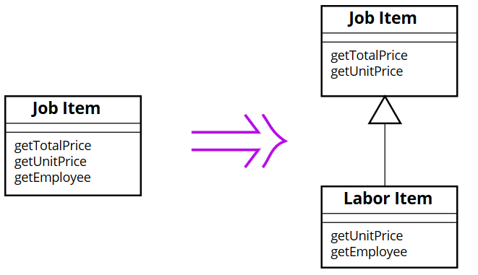
Extract Subclass
Problem: A class has features that are used only in certain cases.
Solution: Create a subclass and use it in these cases.
Inverse of collapse hierarchy

Slide 30
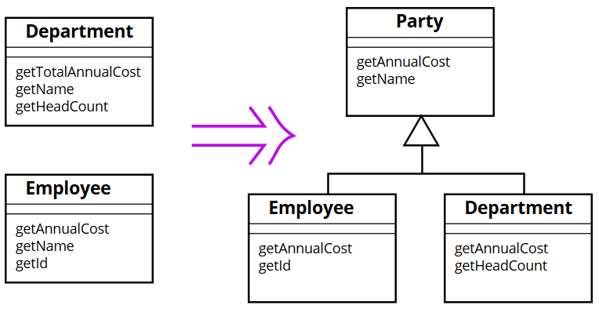
Extract Superclass
Problem: You have 2 classes with common fields & methods.
Solution: Create a shared superclass for them and move all the identical fields and methods to it.
Inverse of collapse hierarchy

Slide 31
Extract Superclass
class Party {
get name() {...}
get annualCost() {...}
}
class Department extends Party {
get annualCost() {...}
get headCount() {...}
}
class Employee extends Party {
get annualCost() {...}
get id() {...}
}
class Department {
get totalAnnualCost() {...}
get name() {...}
get headCount() {...}
}
class Employee {
get annualCost() {...}
get name() {...}
get id() {...}
}
Before Refactoring
After Refactoring

Slide 32
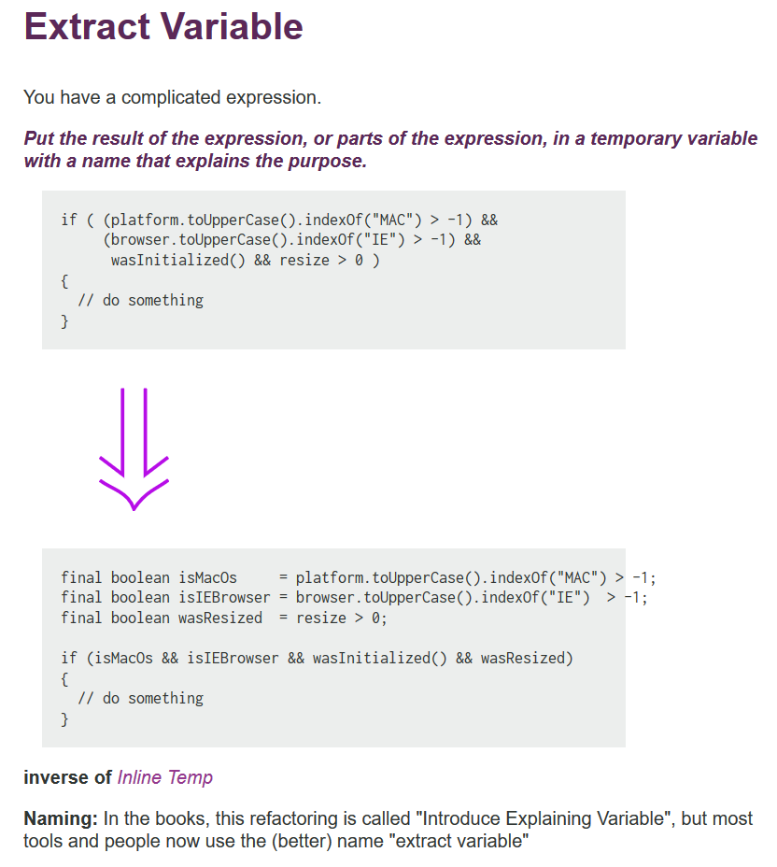
Extract Variable
Problem: have expression that’s hard to understand.
Solution: Place the result of the expression or its parts in separate variables that are self-explanatory.
void renderBanner() {
if ((platform.toUpperCase().indexOf("MAC") > -1) &&
(browser.toUpperCase().indexOf("IE") > -1) &&
wasInitialized() && resize > 0 )
{
// do something
}
}
void renderBanner() {
final boolean isMacOs = platform.toUpperCase().indexOf("MAC") > -1;
final boolean isIE = browser.toUpperCase().indexOf("IE") > -1;
final boolean wasResized = resize > 0;
if (isMacOs && isIE && wasInitialized() && wasResized) {
// do something
}
}
Before Refactoring
After Refactoring

Slide 33
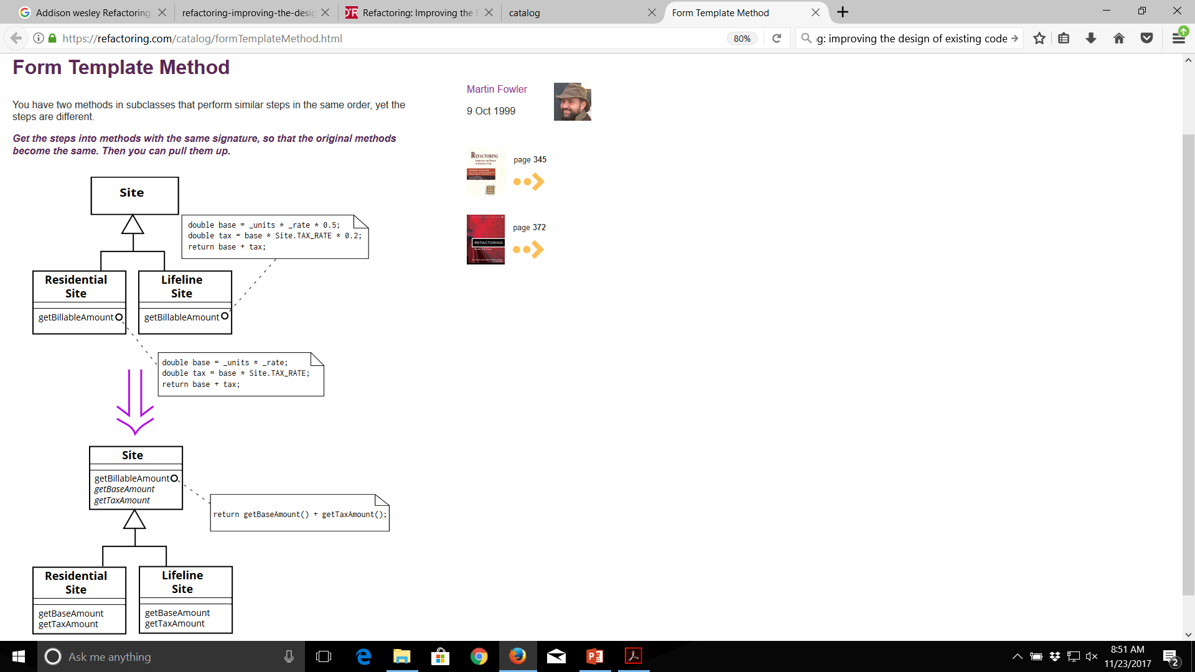

Slide 35
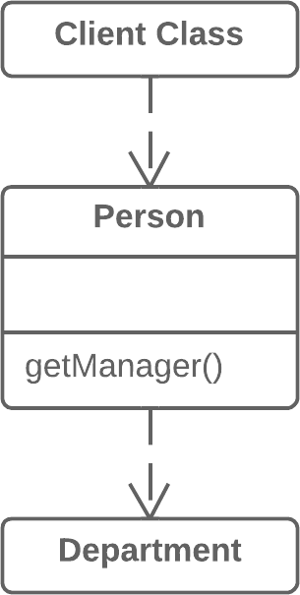
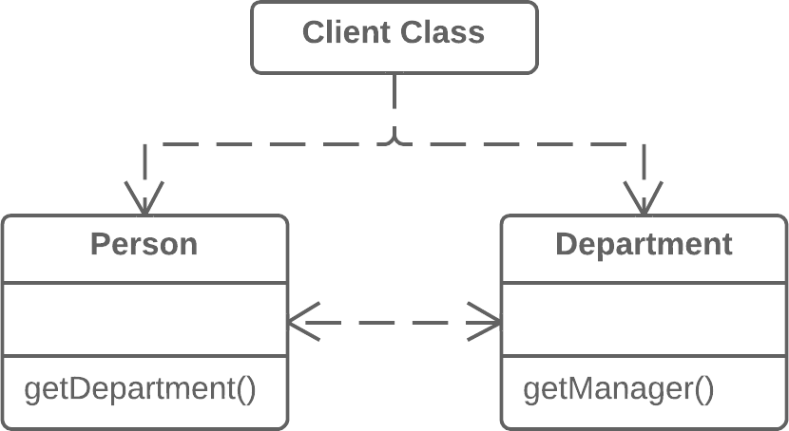


Hide Delegate
Problem: client gets object B from a field or method of object А. Then client calls a method of object B.
Solution: Create a new method in class A that delegates the call to object B. Now the client doesn’t know about, or depend on, class B.
Inverse of remove middle man
manager = aPerson.department.manager;
manager = aPerson.manager;
class Person {
get manager() {return this.department.manager;}

Slide 36
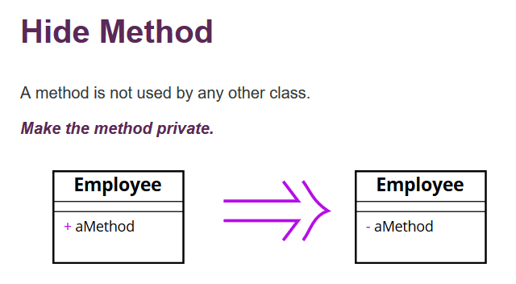

Slide 37
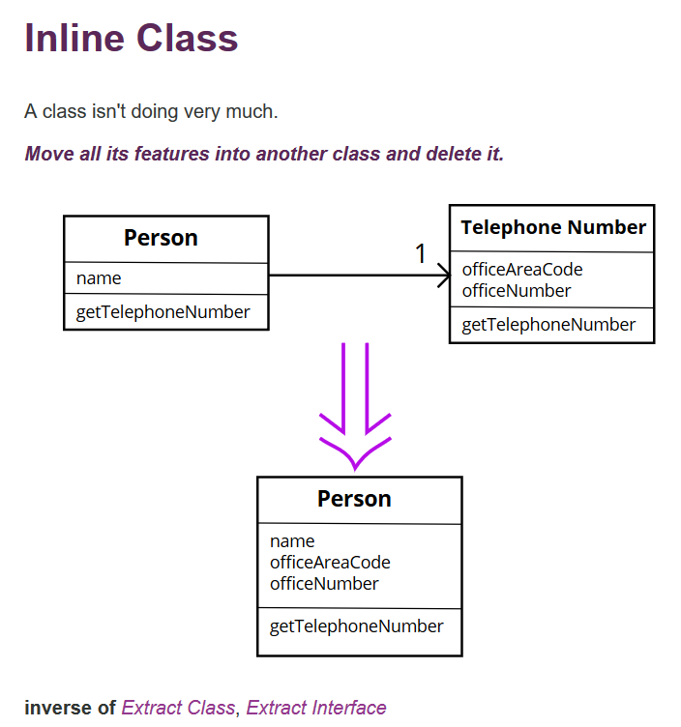
Continued…

Slide 38
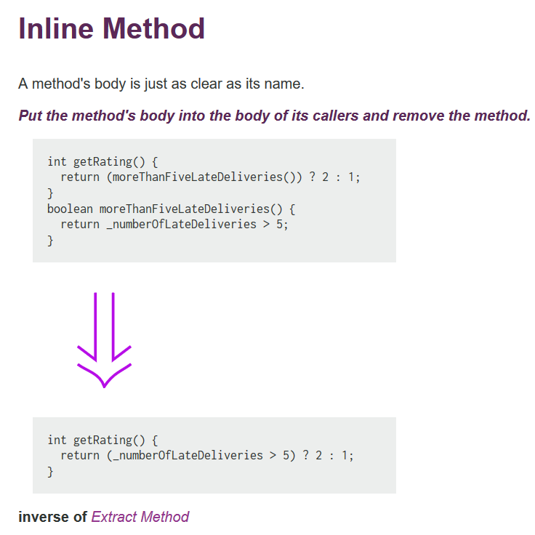

Slide 39
Bad Smells in Code
Parallel Interface Hierarchies
Lazy Class
Speculative Generality
Temporary Field
Message Chains
Middle Man
Inappropriate Intimacy
Incomplete Library Class
Data Class
Refused Bequest
Duplicated Code
Long Method
Large Class
Long Parameter List
Divergent Change
Shotgun Surgery
Feature Envy
Data Clumps
Primitive Obsession
Switch Statements

Slide 40
Few solutions to Bad Smells
Duplicated Code
If you see the same code structure in more than one place, you can be sure that your program will be better if you find a way to unify them.
solution: perform EXTRACT METHOD and invoke the code from both places.
Long Method
The longer a procedure is the more difficult it is to understand.
solution: perform EXTRACT METHOD or Decompose Conditional or Replace Temp with Query.

Slide 41
Large class
When a class is trying to do too much, it often shows up as too many instance variables.
solution: perform EXTRACT CLASS or SUBCLASS
Long Parameter List
With objects you don't need to pass in everything the method needs, instead you pass in enough so the method can get to everything it needs
solution: Use REPLACE PARAMETER with METHOD when you can get the data in one parameter by making a request of an object you already know about.

Slide 42
Shotgun Surgery
This situation occurs when every time you make a kind of change, you have to make a lot of little changes to a lot of different classes.
solution: perform MOVE METHOD/FIELD or INLINE Class bring a whole bunch of behavior together.
Feature Envy
It is a method that seems more interested in a class other in the one that it is in.
solution: perform MOVE METHOD or EXTRACT METHOD on the jealous bit and get it home.

Slide 43
Switch Statements
They are generally scattered throughout a program. If you add or remove a clause in one switch, you often have to find and repair the others too.
solution: Use EXTRACT METHOD to extract the switch statement and then MOVE METHOD to get it into the class where the polymorphism is needed.

Slide 44
Benefits of Refactoring
Refactoring is useful to any program that has at least one of the following shortcomings:
Programs that are hard to read are hard to modify.
Programs that have duplicate logic are hard to modify

Slide 45
Continued…
Programs that require additional behavior that requires you to change running code are hard to modify.
Programs with complex conditional logic are hard to modify.

Slide 46
Refactoring Risks
Introducing a failure with refactoring can have serious consequences.
When done on a system that is already in production, the consequences of introducing bugs without catching them are very severe.

Slide 47
Costs of Refactoring
Language / Environment :
Depends on how well the operations on the source code are supported. But in general the cost of applying the basic text modifications should be bearable.
Testing :
Relies heavily on testing after each small step and having a solid test suite of unit tests for the whole system substantially reduces the costs which would be implied by testing manually

Slide 48
Continued…
Documentation :
Costs of updating documentation of the project should not be underestimated as applying refactorings involves changes in interfaces, names, parameter lists and so on.
All the documentation concerning these issues must be updated to the current state of development.

Slide 49
Continued…
System :
The tests covering the system need an update as well as the interfaces and responsibilities change. These necessary changes can contribute to higher costs as tests are mostly very dependent on the implementation.

Slide 50
When to put Off Refactoring ?
Concerned code is neither able to compile or to run in a stable manner, it might be better to throw it away and rewrite the software from scratch.
When a deadline is very close. Then it would take more time to do the refactoring than the deadline allows.

